Slide 1
RoshDip
Agriculture Management System

Slide 2
Problem Statement
Farming is the Prime Occupation in India, The Advanced techniques and the Automated machines which are leading the world to new heights are been lagging when it is concerned to Farming, either the lack of awareness of the advanced facilities or the unavailability leads to poverty in Farming. Even after all the hard work and the production done by the farmers, in today’s market, the farmers are cheated by the Agents, leading to poverty. Agro-marketing would make all things automatic which makes it easier to serve as the best solution to all the problems. RoshDip farming will serve as a way for the farmers to sell their products cross the city just with some basic knowledge about how to use the website.

Slide 3
Objective of the project:
The main objective of developing “RoshDip” application is to help farmers by providing all kinds agriculture related information in the website. “RoshDip” is Agriculture management website application which helps farmers to give best-practice farming processes. It helps farmers to improve their productivity and profitability. It enables farmers to sell their products online and farmers can purchase tools and seeds directly from seller.

Slide 4
Information about RoshDip :
‘RoshDip' is a Agriculture management website.
This site helps the farmers to sell their agricultural produce online and suggests best -in-practice farming processes.
Hence, providing a wider market and helping them to not restrict themselves to the local market.
It features online shopping for Fruits,Seeds, Vegetables & Spices, etc.
As a whole, ‘RoshDip’ provides a concept of virtual agricultural trade to its users.

Slide 5
User classes and characteristics:
There are 3 kinds of users for the proposed system.
Administrators:
Administrators are the ones who can add or administer the categories for the products, and administers the all website information’s. Administrator has full privilege of the website.

Slide 6
User classes and characteristics:
Sellers:
Sellers are the farmers and they can sell their productions through online after the registration. After the registration the farmers can login to the system by entering login id and password.
Update Profile

Slide 7
User classes and characteristics:
Customer:
Customers can buy products through online. The customer can send purchase request to farmer.

Slide 8
Project Category:
RDBMS (Relational Database Management System)
Language(s) to be used:
Design and Interface: HTML ,CSS
Programming language: PHP
Scripting language: Javascript
Scripting server: Apache server
Data Base server: MySQL

Slide 9
Modules of the project
Customer account module
Product module
Category module
Location module
Production module
Purchase order module
Seller module
Article and blog module
Dashboard Module
Purchase request module

Slide 10
Functional Requirements:
Login module:
In this module, the customer, seller and the admin can login to the system by entering login id and password. The system opens main account page after the login.
Customer module:
The customer can register to the website by entering profile details. The customer can purchase products which are uploaded by administrator. They can also send purchase request for purchasing farm produce which is uploaded by farmers. After quality test and price quotation, the customer can approve or reject the purchase request.
Seller module:
The farmers are the sellers where they can sell their productions online. The system will display farm produces in the main page of the website.

Slide 11
Functional Requirements
Dashboard module:
Dashboard module is for administrator and employees. In the dashboard module, admin has complete settings of the website. Employees can manage all kinds of records.
Article module:
In the article module, employees or admin can post news and blogs. This article module is helpful for farmers. The farmers can view the article by browsing article menu.

Slide 12
Functional Requirements:
Category module:
In this module, the administrator can create different types of categories. The system has three types of categories: i.e. Farm Produce, Agricultural Machinery & Tools, and Article types.
Location module:
This is the master page where admin can add country, state, city.
Products module:
This website sells two kinds of products. Admin or employees can sell products directly and it has another option where farmers can sell their productions online.
Billing Report:
The system generates billing after purchasing the product. The system calculates total cost automatically. In the billing report, it displays customer contact details, billing details, and purchased product information.

Slide 13
System Design

Slide 14
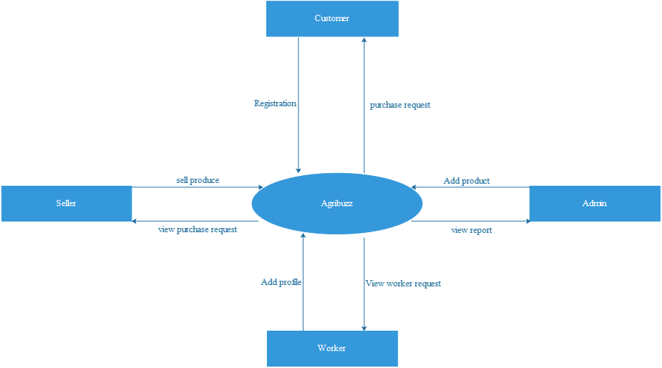
Context Flow Diagram
The Context Flow Diagram (CFD) describes the external entities acting on the system. The environment in which the system is used is depicted in the figure.
RoshDip

Slide 15
Data Flow Diagram
A Data Flow Diagram (DFD) is a graphical representation of the “flow” of data through an Information System.
A DFD also can be used for the visualization of Data Processing. It is common practice for a designer to draw a context-level DFD first which shows the interaction between the system and outside entities.
This context-level DFD is then “exploded” to show more detail of the system being modeled

Slide 16
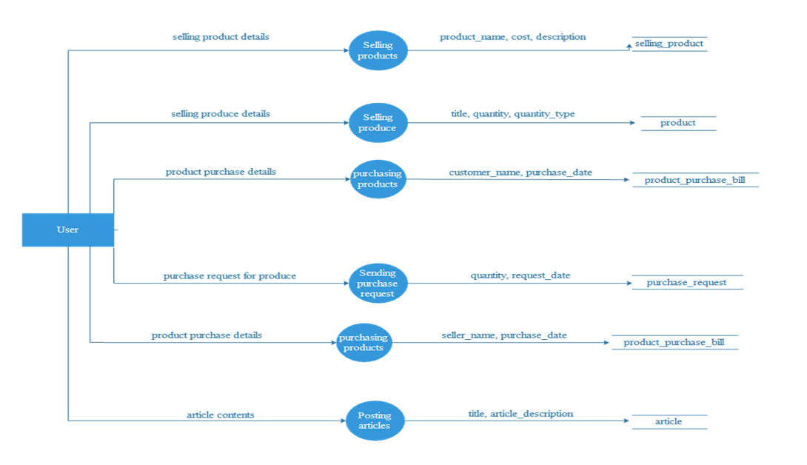
Top Level DFD – Level 1:

Slide 17
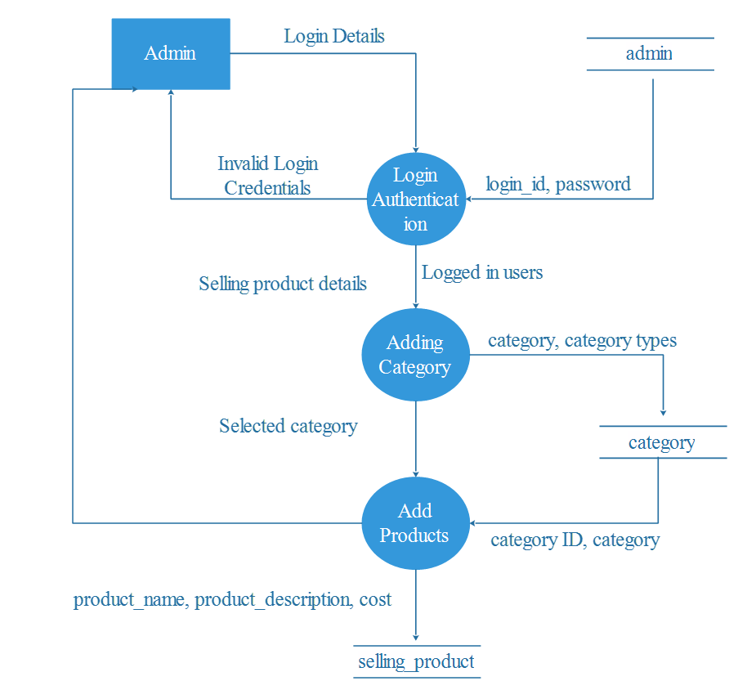
DFD Level 2:

Slide 18
DFD Level 3:

Slide 19
DFD Level 4:

Slide 20
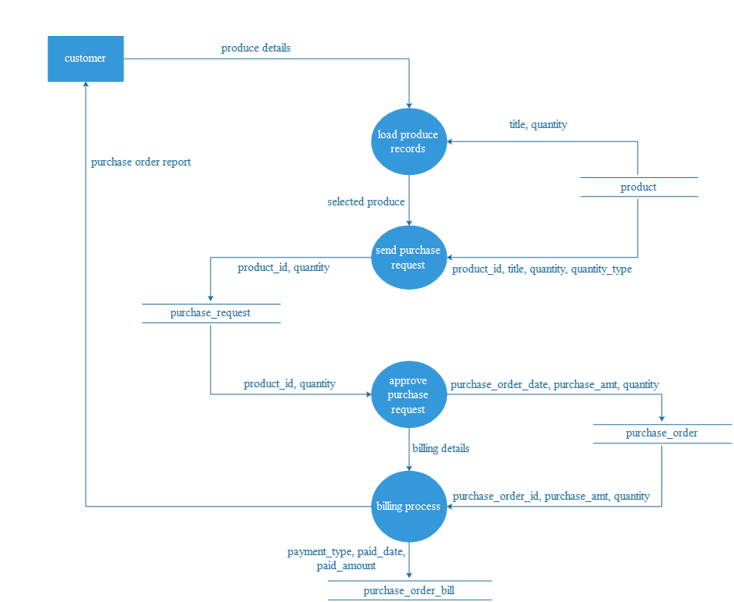
DFD Level 5:

Slide 21
DFD Level 7:­­­

Slide 22
Database Design

Slide 23
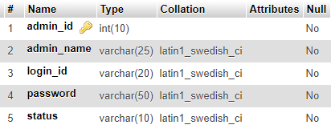
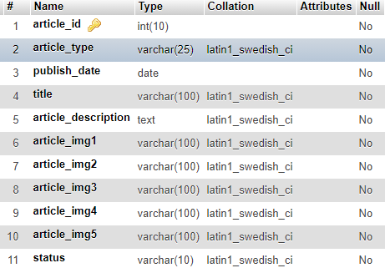
Admin table
Article table

Slide 24
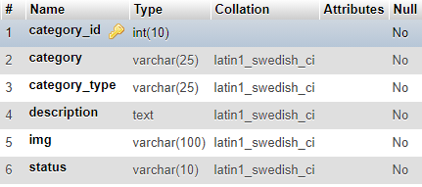
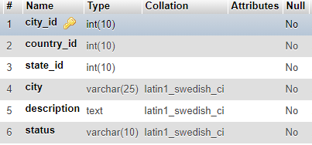
Category table
City table

Slide 25
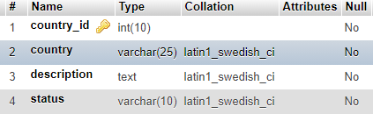
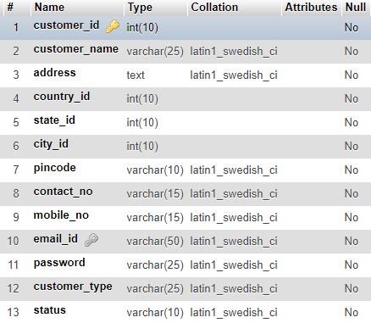
Country table
Customer table

Slide 26
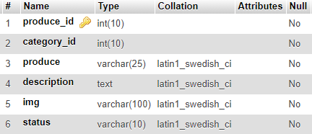
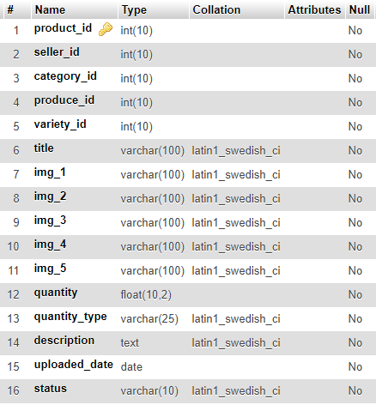
Produce table
Product table

Slide 27
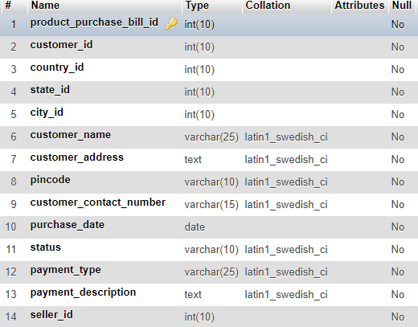
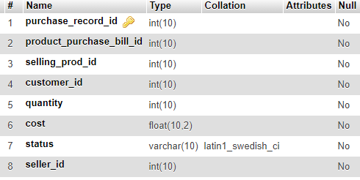
Product purchase bill table
Purchase order record table

Slide 28
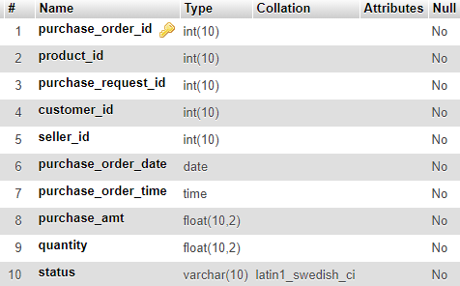
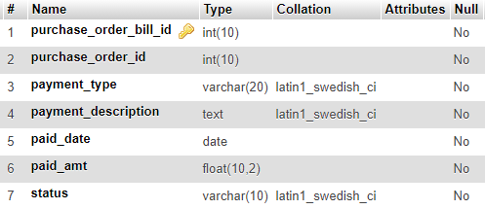
Purchase order table
Purchase order bill table

Slide 29
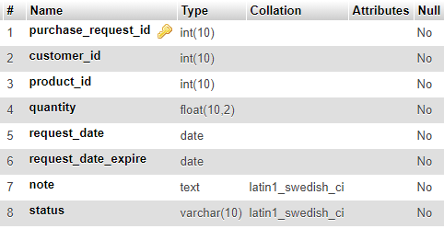
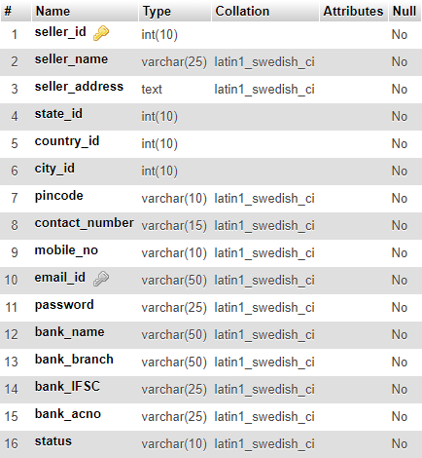
Purchase request table
Seller table

Slide 30
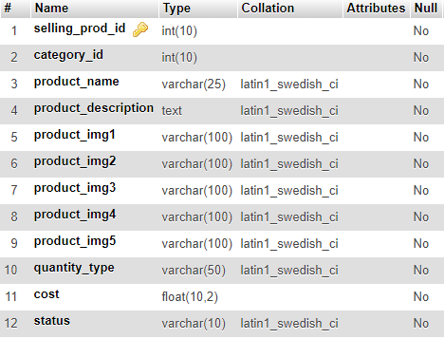
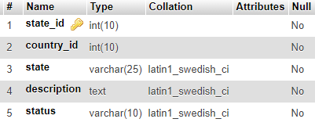
Selling product table
State table

Slide 31
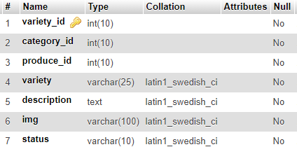
Variety table

Slide 32
TESTING

Slide 33
Levels of Testing:
Unit Testing
Integration Testing
System Testing

Slide 34
Admin Component
Serial No. | Condition To be Tested | Test Data | Expected Output | Remarks
1. | If any field in the form is empty. | Value of form fields. | Alert the user to enter all the fields and then proceed. | SUCCESSFUL
2. | If admin name contains other than Character values. | adminname | Alert the user to enter only Characters and return to same page. | SUCCESSFUL
3. | If login ID is invalid. | loginid | Alert the user to enter a valid login ID and return to the same page. | SUCCESSFUL
4. | If password length is not between 8 to 16 characters. | password | Alert the user to enter a password of length between 8 to 16 characters. | SUCCESSFUL
5. | If confirm password and password does not match. | cpassword, password | Alert the user to enter matching password and confirm password. | SUCCESSFUL

Slide 35
Customer login:
Serial No. | Condition To be Tested | Test Data | Expected Output | Remarks
1. | If any field in the form is empty. | Value of form fields. | Alert the user to enter all the fields and then proceed. | SUCCESSFUL
2. | If the E-mail ID and Password does not match. | emailid, password | Alert user that E-mail ID and password are not matching and stay in the same page. | SUCCESSFUL

Slide 36
Variety Component
Serial No. | Condition To be Tested | Test Data | Expected Output | Remarks
1. | If field in the form is empty. | Value of form fields. | Alert the user to enter the fields and then proceed. | SUCCESSFUL
2. | If category is not selected. | category | Alert the user to select a category. | SUCCESSFUL
3. | If produce is not selected. | produce | Alert the user to select a produce. | SUCCESSFUL
4. | If variety contains values other than characters. | variety | Alert the user to enter only characters for variety. | SUCCESSFUL
5. | If image is not selected. | img | Alert the user to select an image. | SUCCESSFUL

Slide 37
Produce component
Serial No. | Condition To be Tested | Test Data | Expected Output | Remarks
1. | If any field in the form is empty. | Value of form fields. | Alert the user to enter all the fields and then proceed. | SUCCESSFUL
2. | If category is not selected. | category | Alert the user to select a category. | SUCCESSFUL
3. | If produce is not selected. | produce | Alert the user to select a produce. | SUCCESSFUL
4. | If image is not selected. | img | Alert the user to select an image. | SUCCESSFUL

Slide 38
User Manual

Slide 39
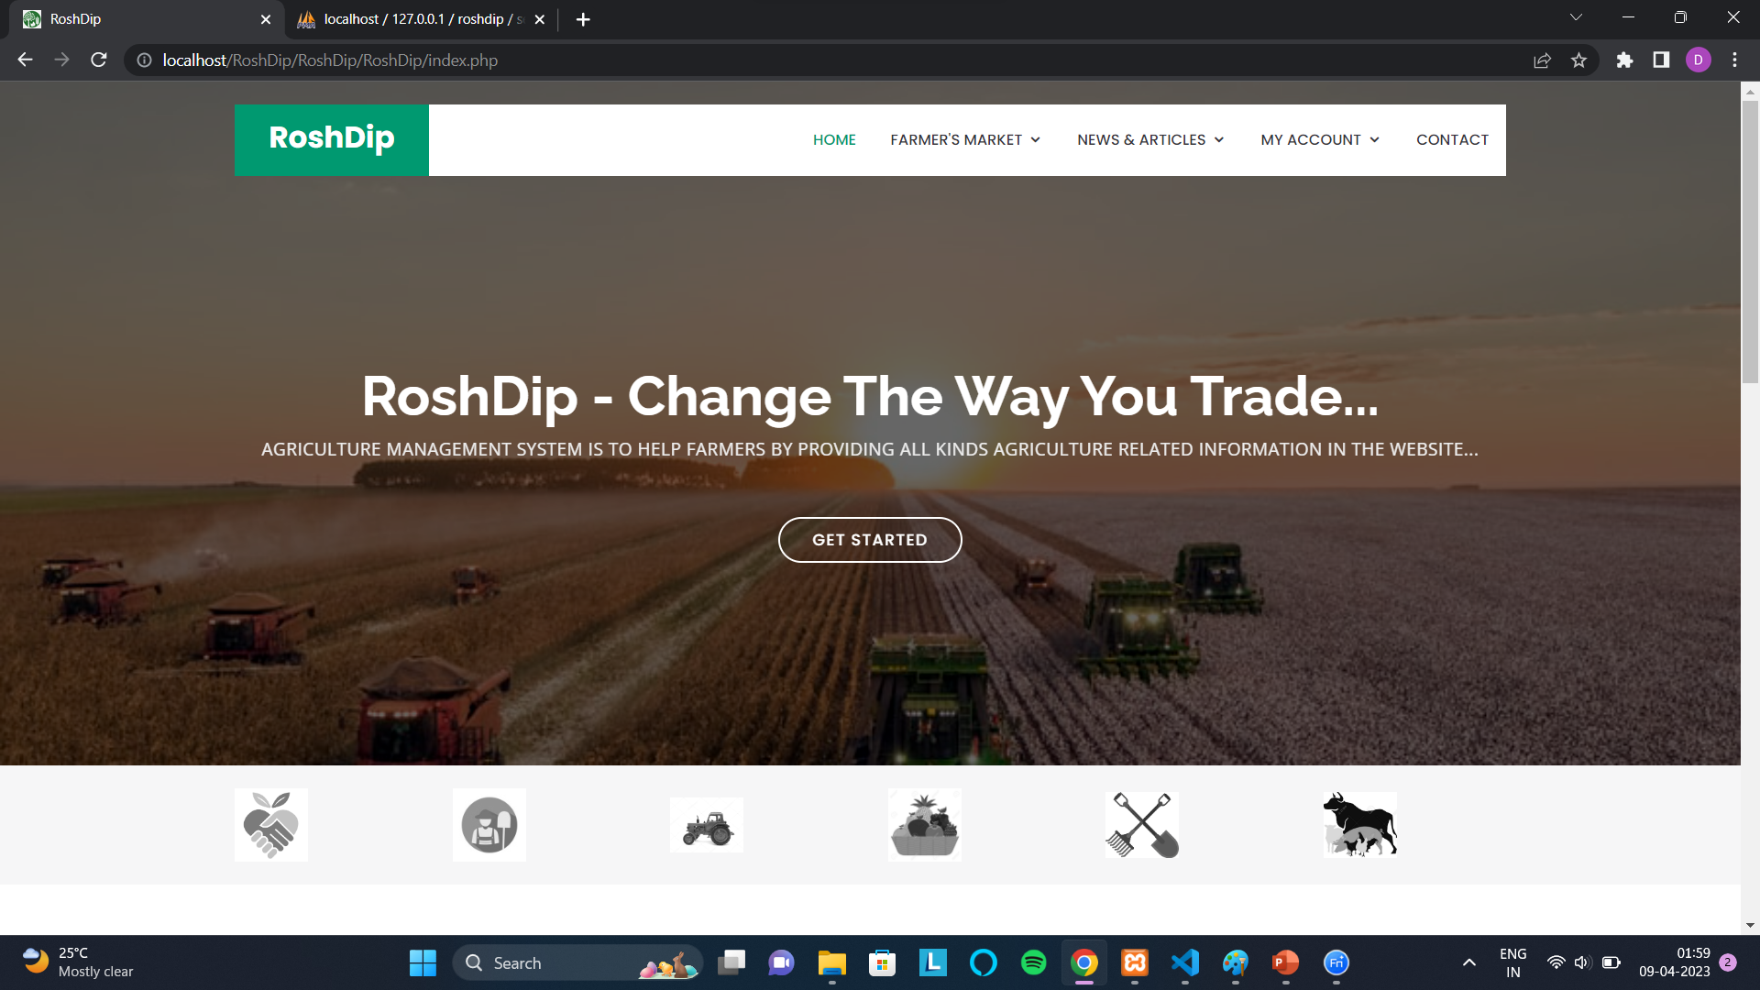

Slide 40
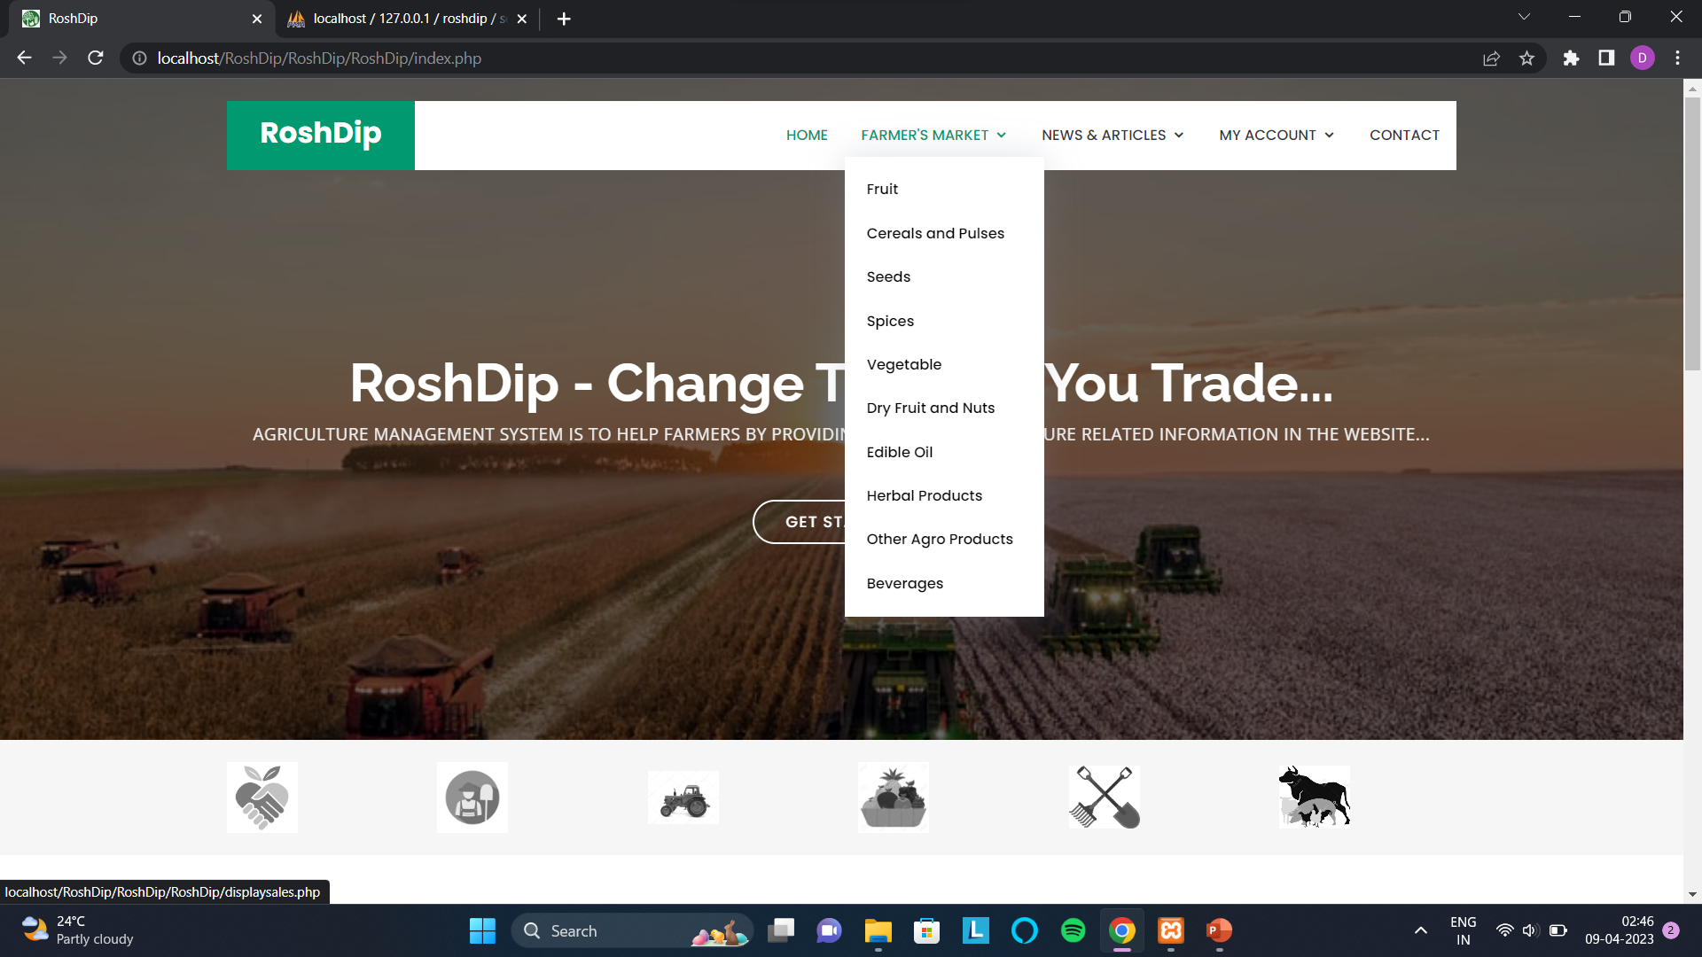

Slide 41
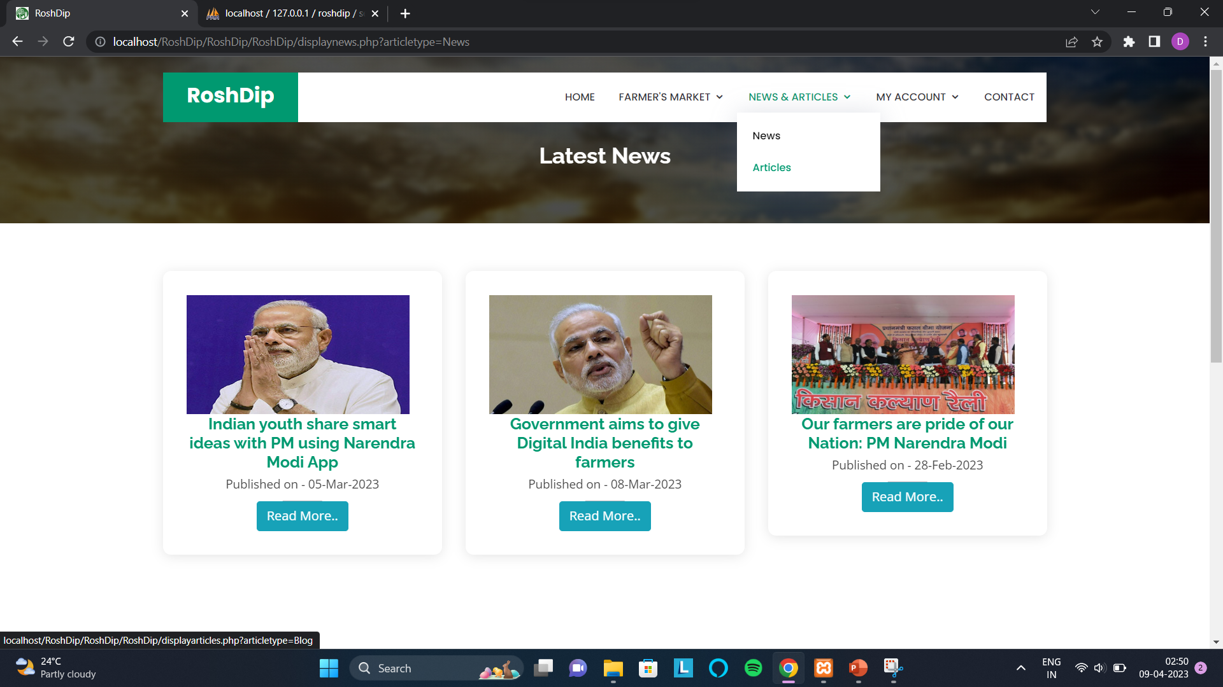
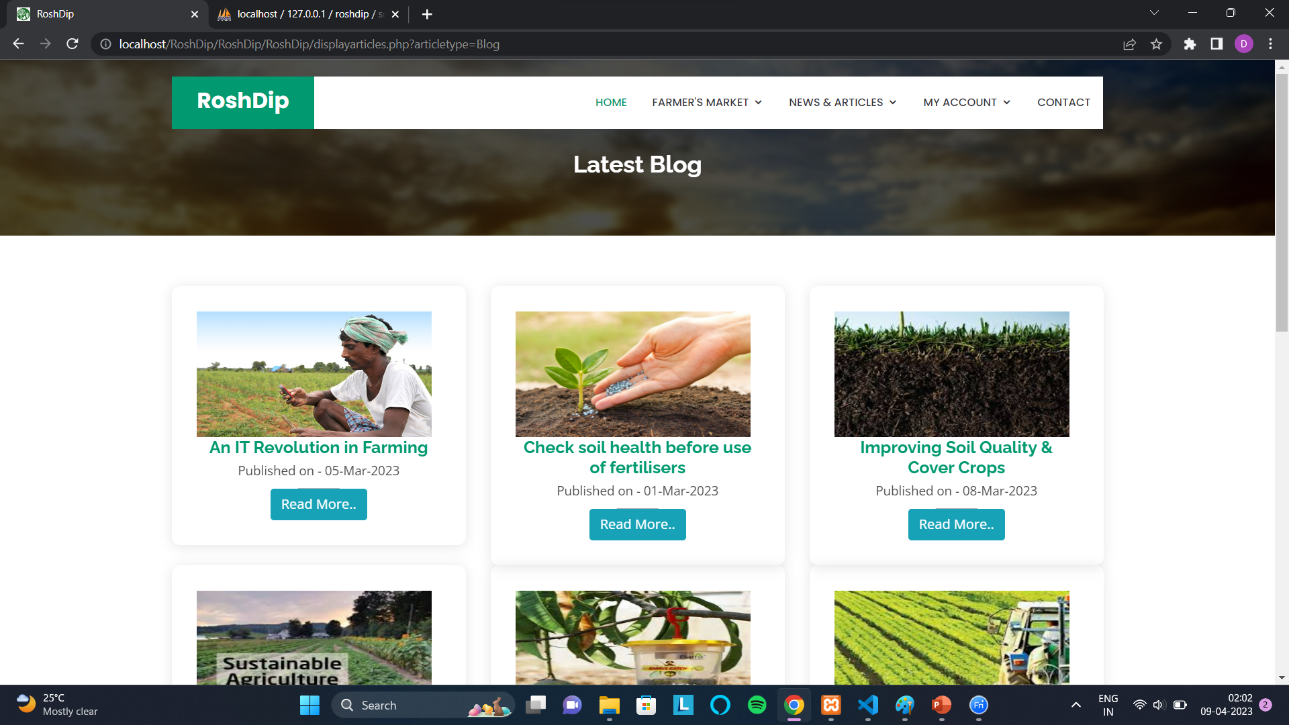

Slide 42
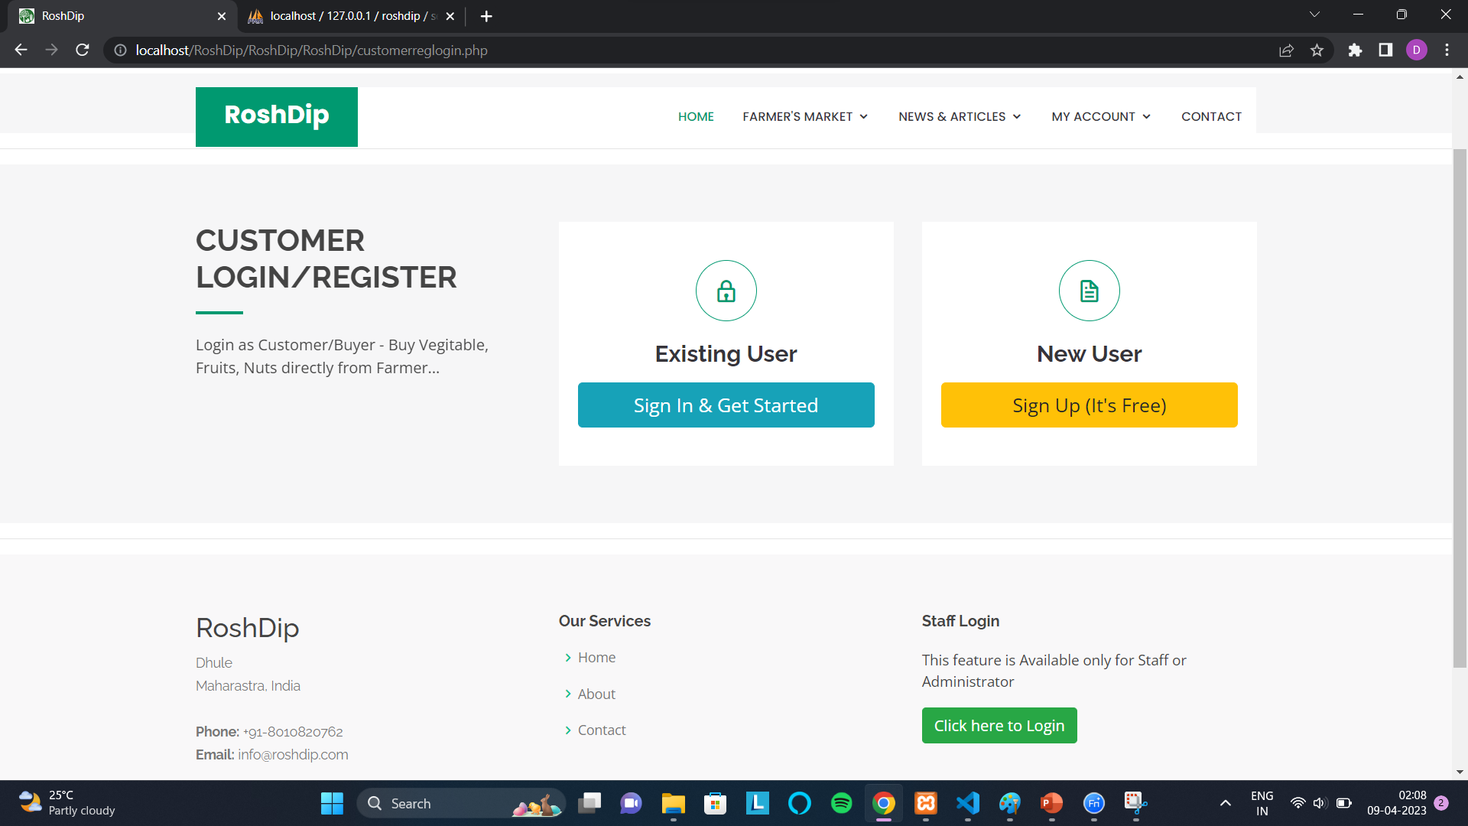

Slide 43
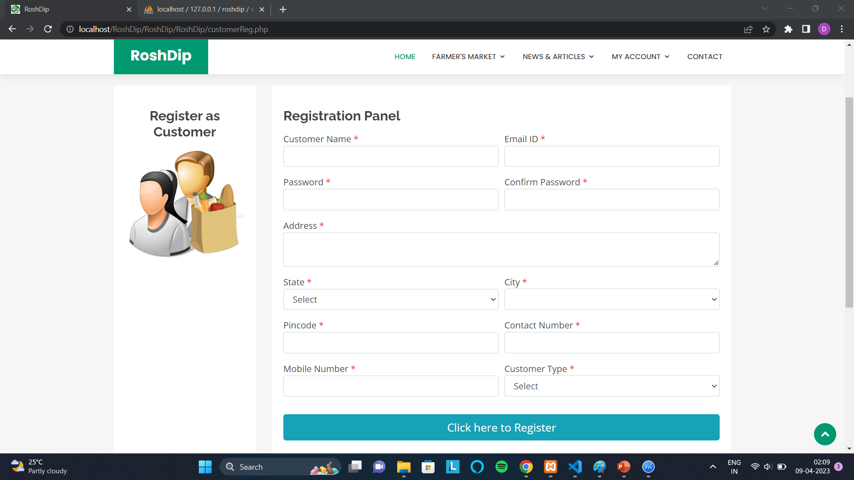
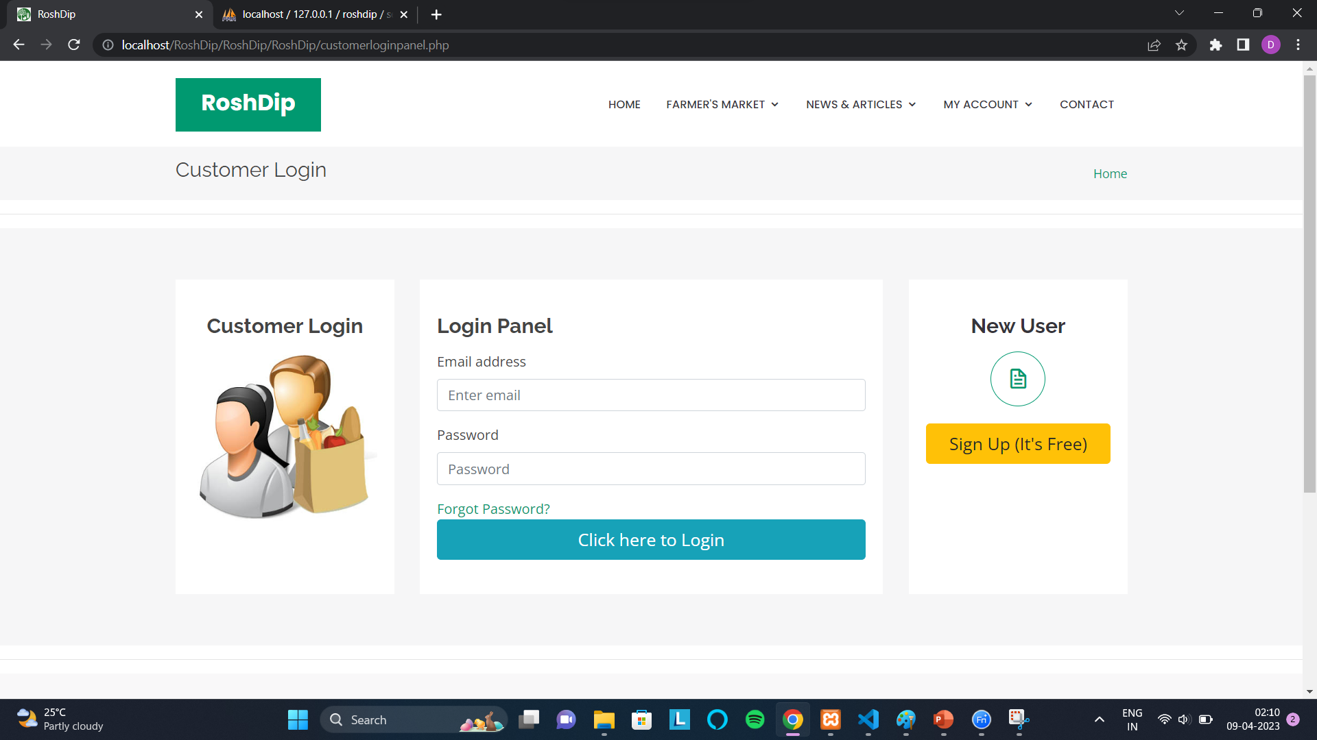

Slide 44
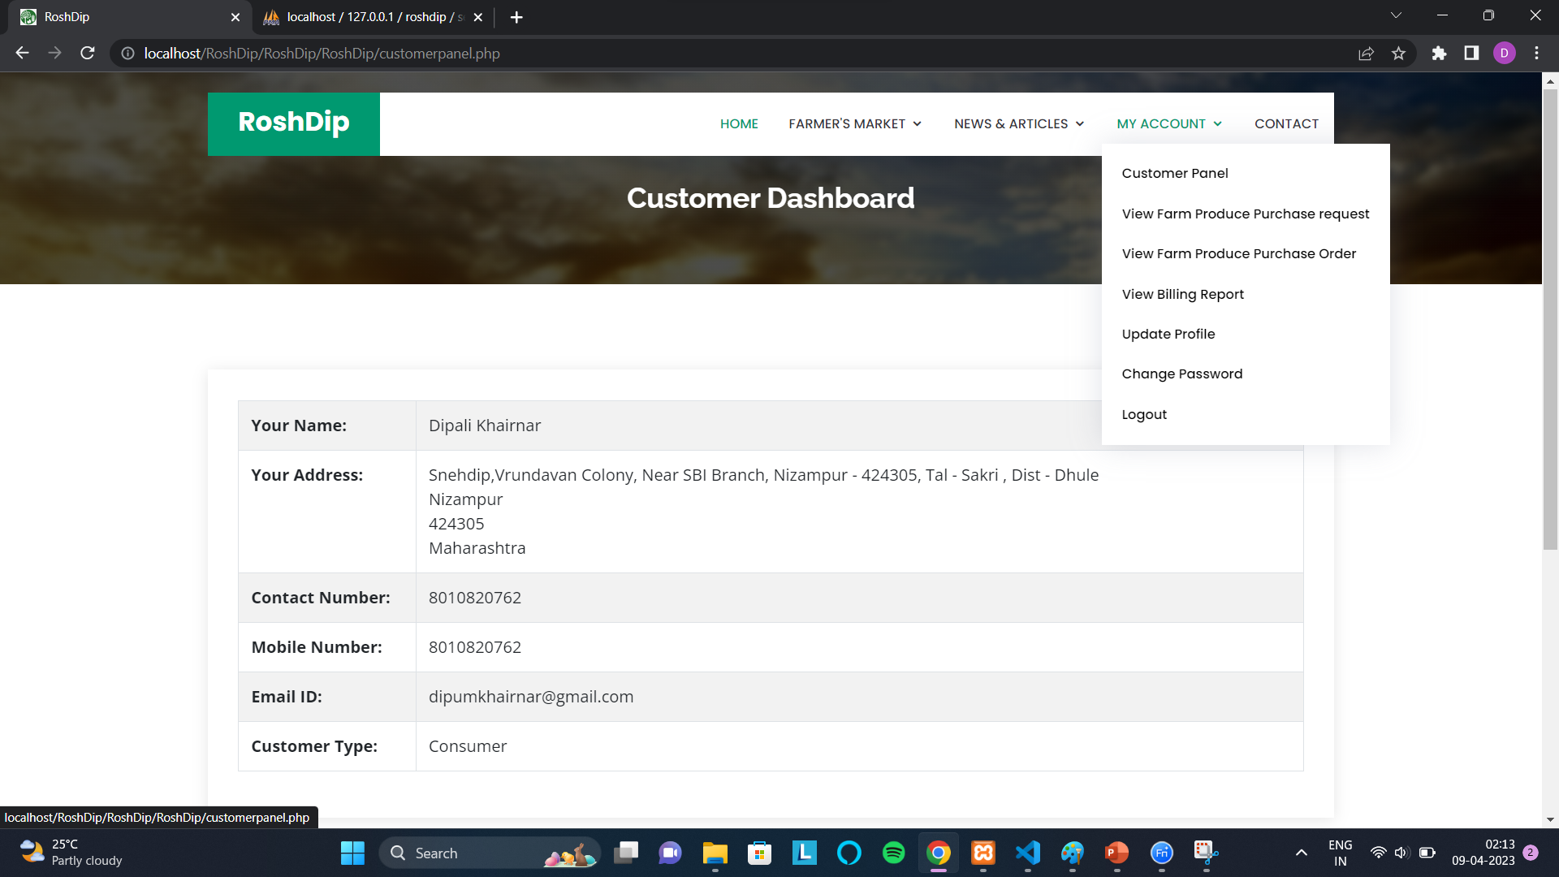

Slide 45
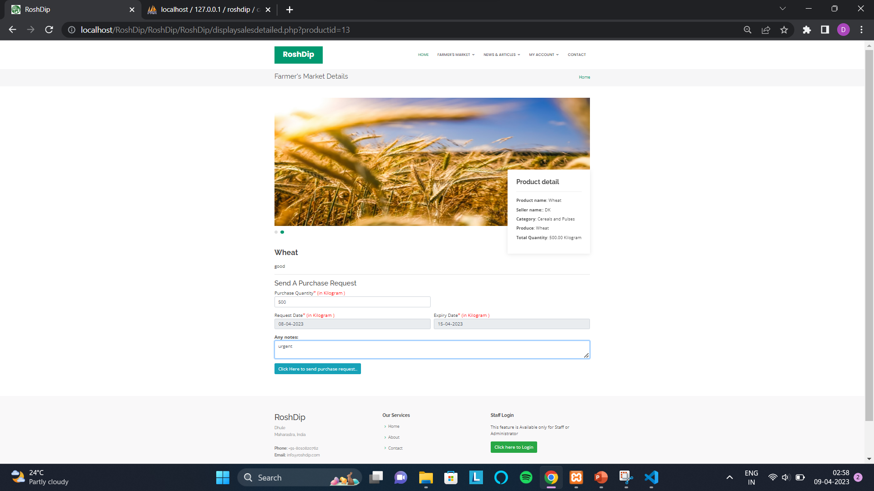

Slide 46


Slide 47
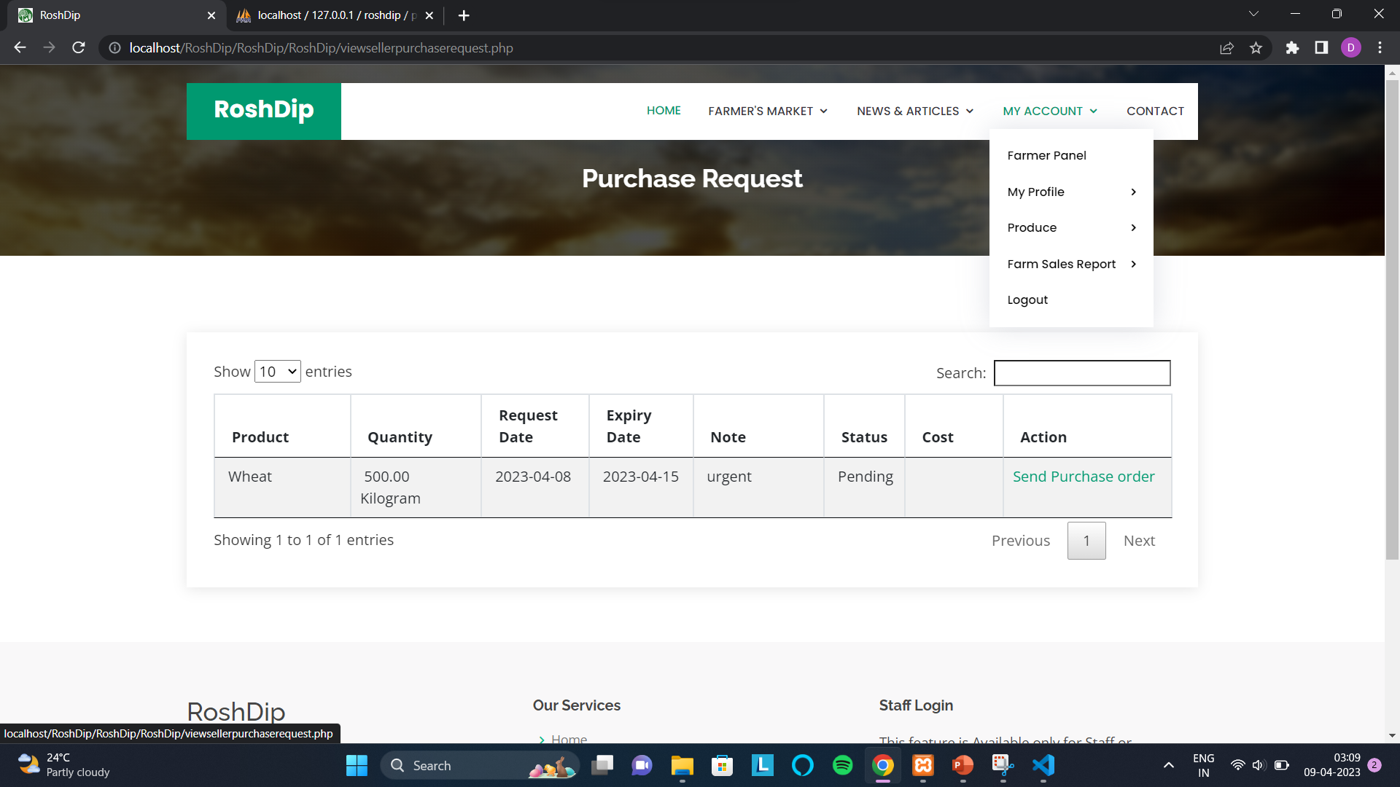

Slide 48
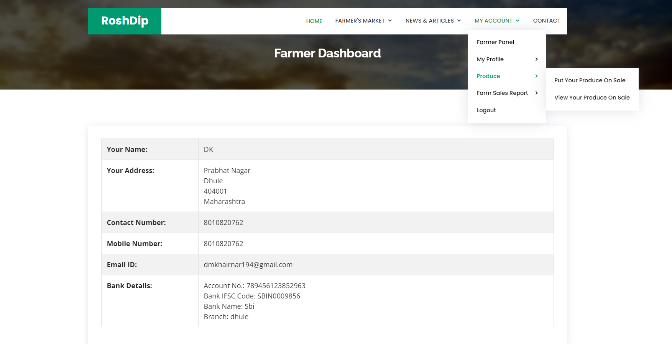

Slide 49
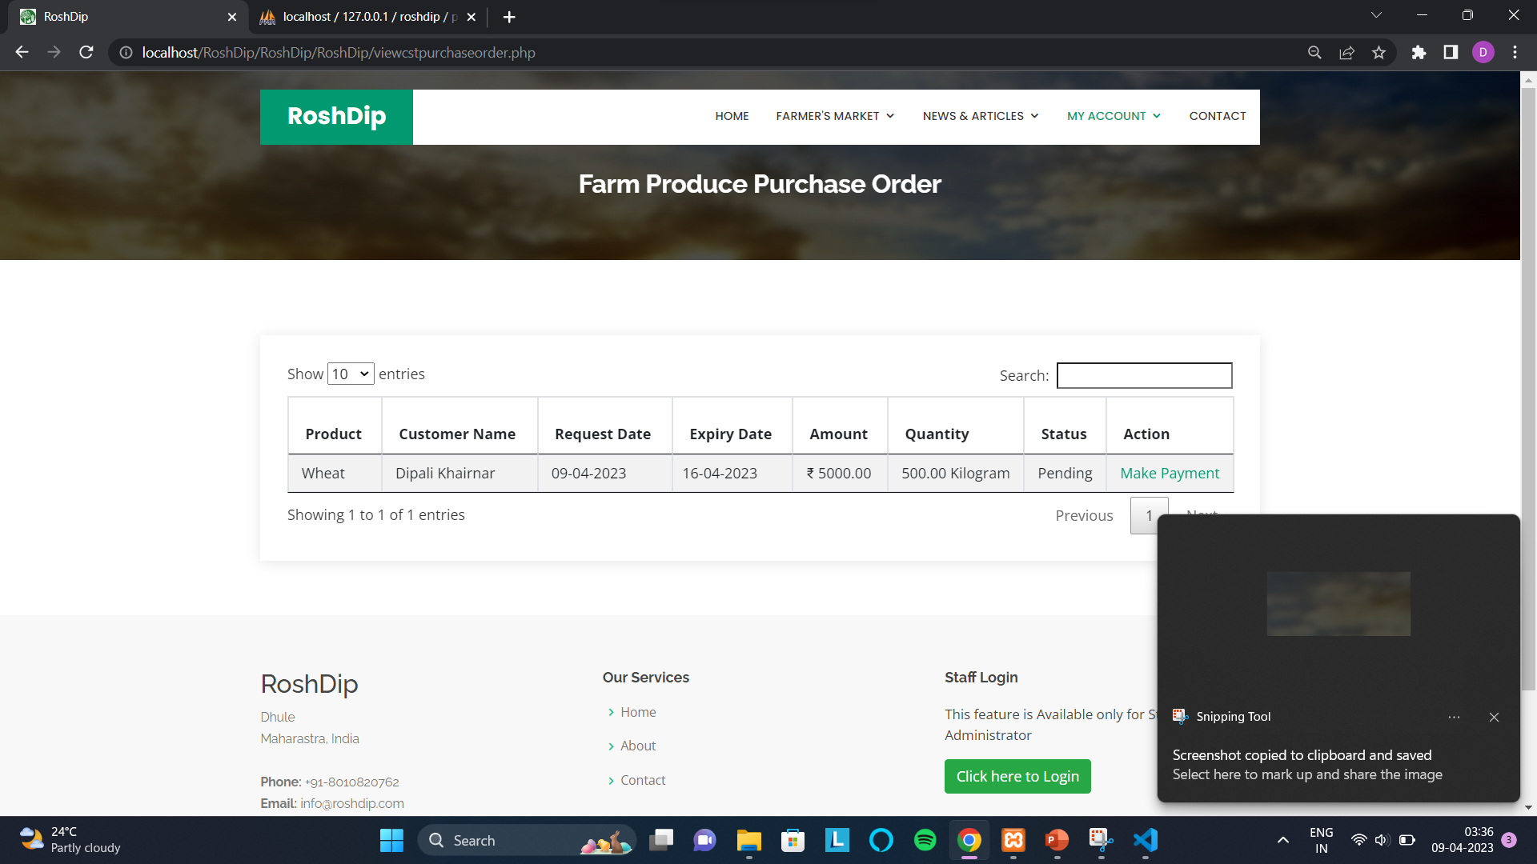
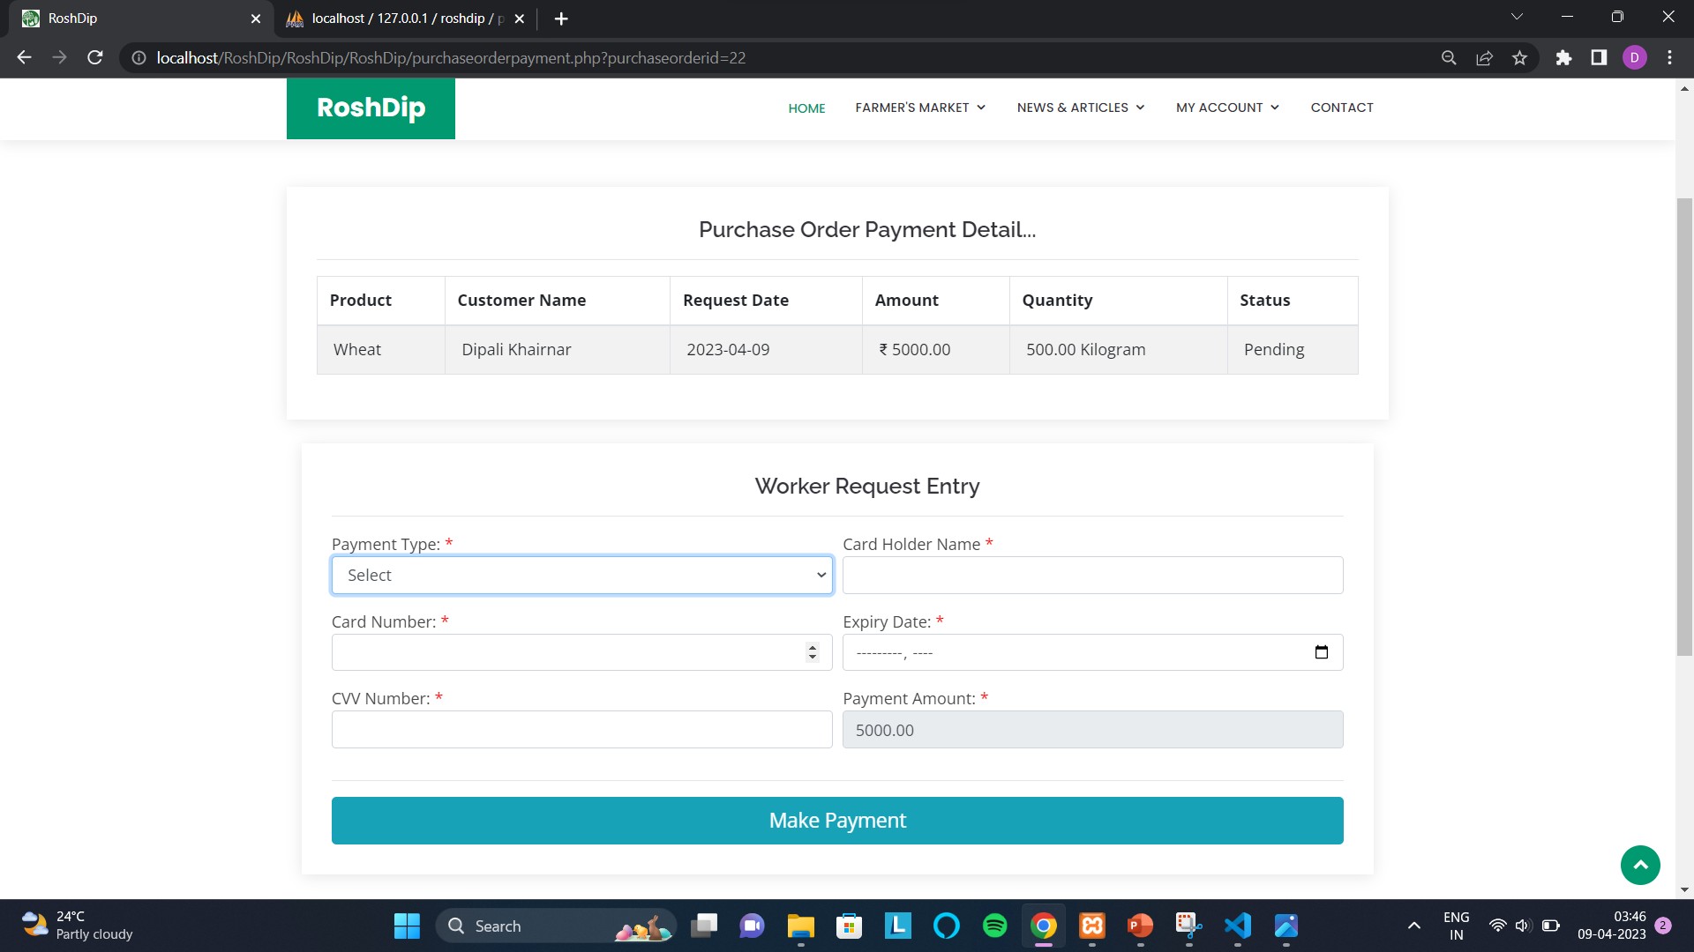

Slide 50
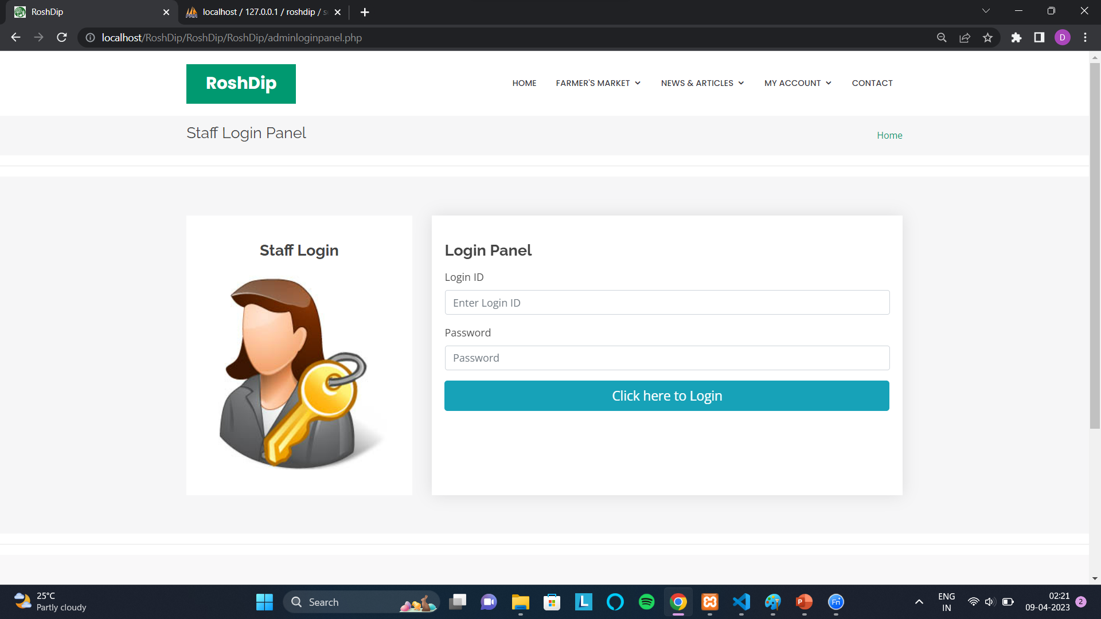

Slide 51
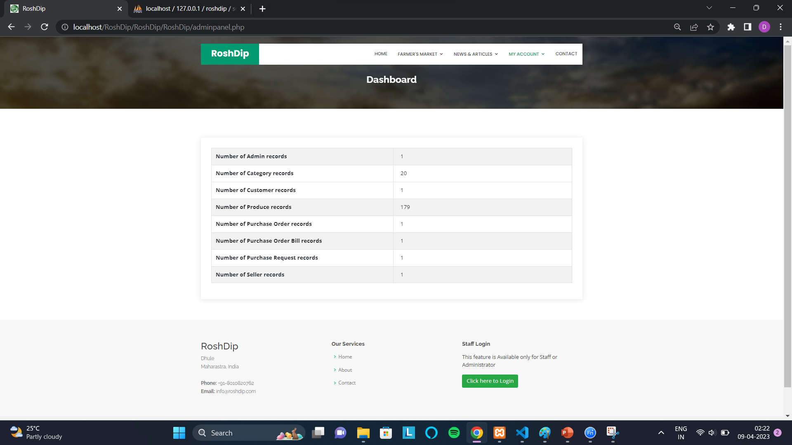

Slide 52
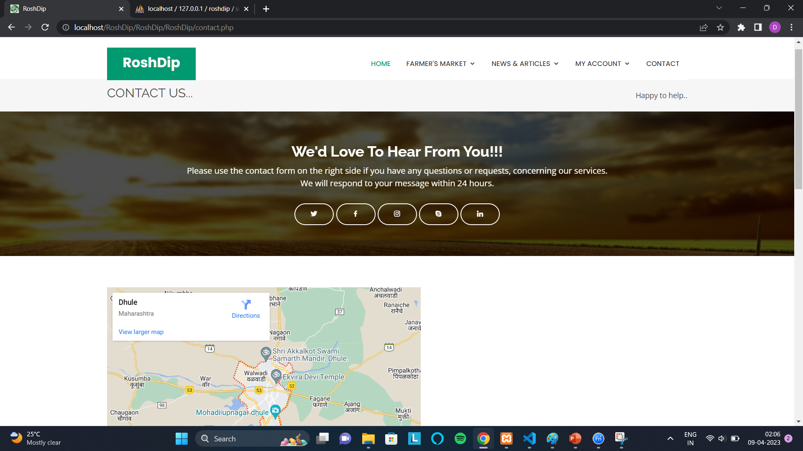
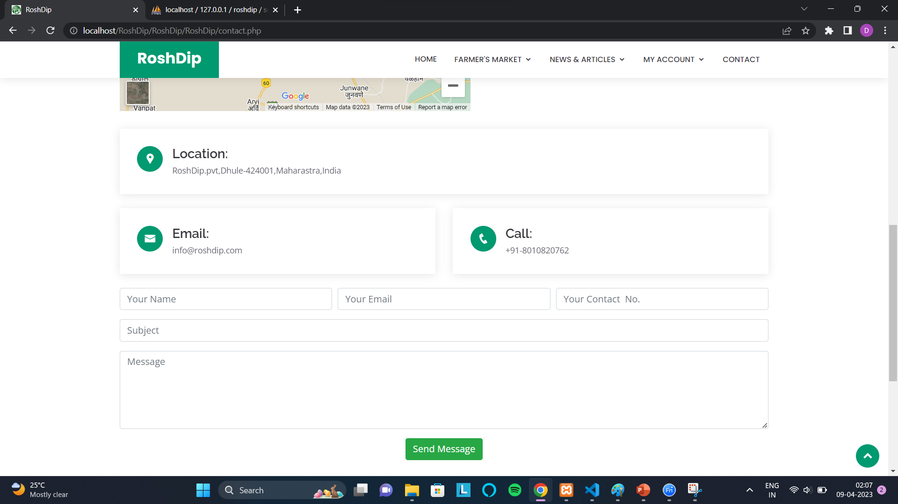

Slide 53
Conclusion

Slide 54
The project “RoshDip” is a man-made project and, therefore, there may be mistakes and limitations.
The ideas put up may be different.
The terms and names may be different.
However, our sincere effort was to give the best.
The advanced techniques like sensor technology can be used in the future for measuring the quality of the product.

Slide 55
Limitations

Slide 56
The project is web application and internet connection is required to access the website.
The administrator and seller should keep status online to check latest transactions.

Slide 57
Future Scope

Slide 58
We can create Android or iOS application for this project.
We can make use of sensor technology to measure the quality of the product.
We can include SMS alert in which the Customer will get alert SMS’s when new item is purchased, New product released, Delivery date, etc.

Slide 59
Thank You

